Slide 1


Accessible, curated metagenomic data through ExperimentHub and Bioconductor July 14, 2017
Levi Waldron
Collaboration with the lab of Nicola Segata

Slide 2
Motivation for curatedMetagenomicData
Increasing amount of public data
Can be fast and free, but hard to use:
fastq files from NCBI, EBI, ...
bioinformatic expertise
computational resources
manual curation / standardization
Wanted to make acquisition of curated, ready-to-use public data easy and reproducible

Slide 3

About Bioconductor
Bioconductor provides ~1,400 packages for analysis of high-throughput genomic data
built on R environment
more than 10,000 R packages in CRAN for statistical analysis and visualization
Rich resources for analysis of microbiome data:
phyloseq, metagenomeSeq, & others

Slide 4
ExperimentHub
Robust, user-friendly distribution of experimental data from the Cloud to Bioconductor:
Data stored in Amazon S3 buckets
Software package of documentation & functions
SQL database for dataset-wide metadata
Convenience functions provide ready-to-analyze Bioconductor data classes
Local caching

Slide 5


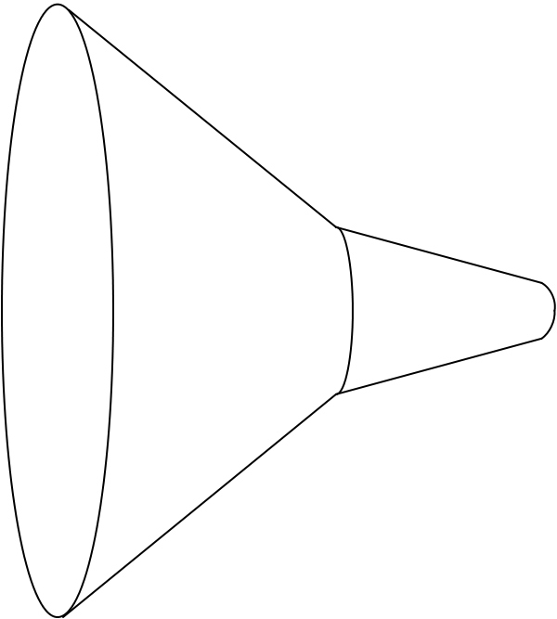
curatedMetagenomicData pipeline
Raw
fastq files
26 datasets
5,716 samples
Study metadata
34 diseases
28 countries
Differential abundance
Diversity metrics
Clustering
Machine learning
Convenience download functions
Megabytes-sized datasets
Download (~63TB)
ExperimentHub product
Amazon S3 cloud distribution
Tag-based searching
Dataset snapshot dates
Automatic local caching
Uniform processing
Manual curation
MetaPhlAn2
HUMAnN2
Automatic documentation
species abundance
metabolic pathway abundance
Integrated Bioconductor ExpressionSet objects
Per-patient microbiome data
Per-patient metadata
Experiment-wide metadata
marker
presence
metabolic pathway presence
Disease, age, body site, etc…
marker abundance
gene family abundance
Integration
Offline high computational load pipeline
> 120 kH CPU, 150TB disk requirements
https://waldronlab.github.io/curatedMetagenomicData/
Notes:
https://upload.wikimedia.org/wikipedia/commons/thumb/7/7e/Funnel_Mech.svg/667px-Funnel_Mech.svg.png
https://pixabay.com/en/cheering-happy-jumping-people-297419/

Slide 6
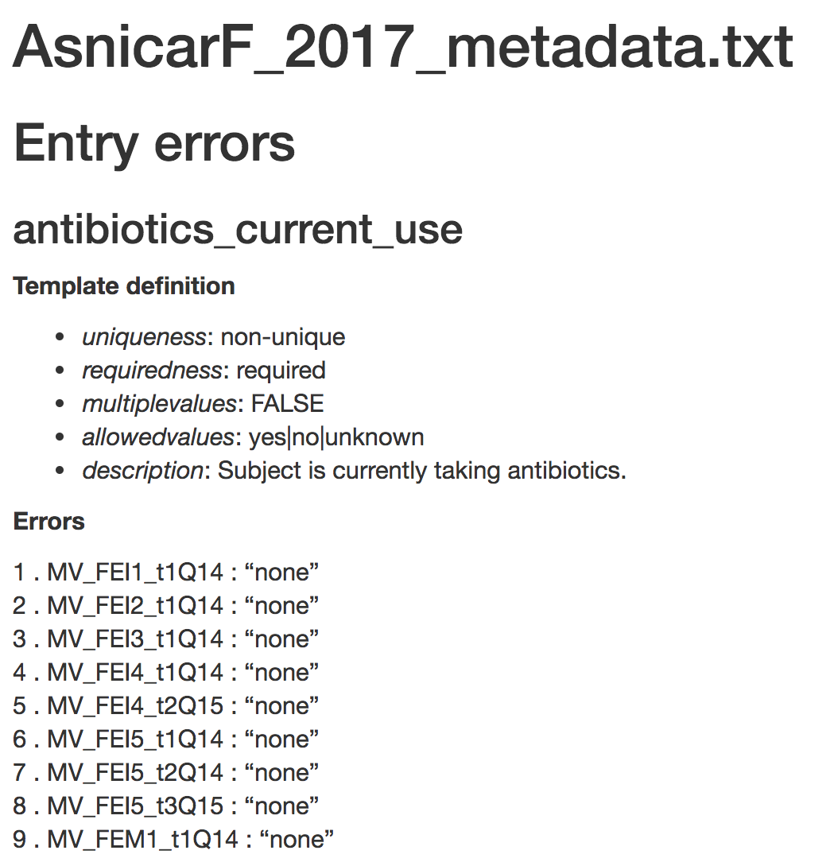
Automatic syntax checking
https://github.com/waldronlab/curatedMetagenomicDataCuration

Slide 7
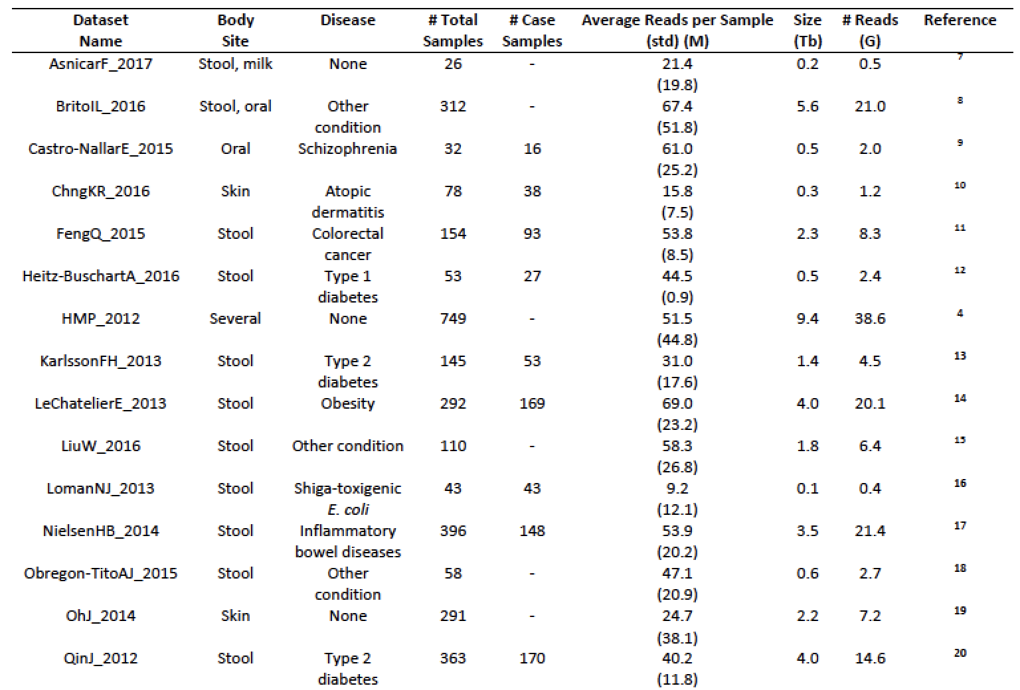
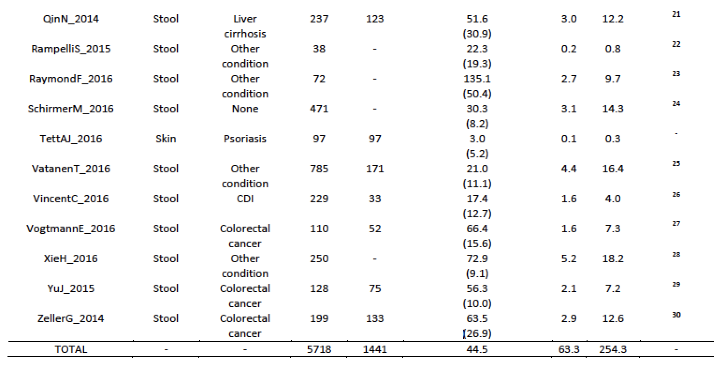
Available datasets
Notes:
Total of 13 datasets with 2,875 samples

Slide 8
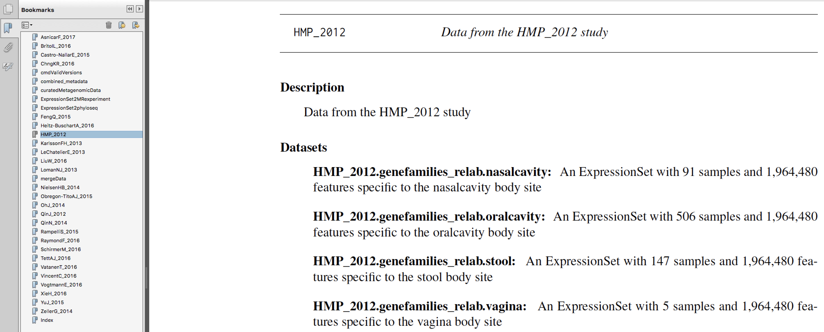
Datasets are documented in manual
Pasolli, Schiffer et al., bioRxiv 103085

Slide 9
One dataset from R
> curatedMetagenomicData("HMP_2012.metaphlan_bugs_list.stool")
Dry run: see return values for datasets that would be downloaded. Run with `dryrun=FALSE` to actually download these datasets.
[1] "HMP_2012.metaphlan_bugs_list.stool”
>
Pasolli, Schiffer et al., bioRxiv 103085

Slide 10
Six data products for stool dataset
> curatedMetagenomicData("HMP_2012.*.stool")
[1] "HMP_2012.genefamilies_relab.stool”
[2] "HMP_2012.marker_abundance.stool"
[3] "HMP_2012.marker_presence.stool"
[4] "HMP_2012.metaphlan_bugs_list.stool"
[5] "HMP_2012.pathabundance_relab.stool"
[6] "HMP_2012.pathcoverage.stool"
>
Pasolli, Schiffer et al., bioRxiv 103085

Slide 11
Integration with MultiAssayExperiment
> system.time(hmpstool <-
curatedMetagenomicData("HMP_2012*stool",
dryrun=FALSE))
…
12.612 1.028 14.152
> library(MultiAssayExperiment)
> mae <- MultiAssayExperiment(hmpstool,
colData=pData(hmpstool[[1]])))
user system elapsed
4.258 1.090 5.492
>
Pasolli, Schiffer et al., bioRxiv 103085

Slide 12
MultiAssayExperiment
Integrating data products for HMP stool:
> mae
A MultiAssayExperiment object of 6 listed
experiments with user-defined names and respective classes.
Containing an ExperimentList class object of length 6:
[1] HMP_2012.genefamilies_relab.stool: ExpressionSet with 1964480 rows and 147 columns
[2] HMP_2012.marker_abundance.stool: ExpressionSet with 162107 rows and 147 columns
[3] HMP_2012.marker_presence.stool: ExpressionSet with 158645 rows and 147 columns
[4] HMP_2012.metaphlan_bugs_list.stool: ExpressionSet with 1988 rows and 147 columns
[5] HMP_2012.pathabundance_relab.stool: ExpressionSet with 23271 rows and 147 columns
[6] HMP_2012.pathcoverage.stool: ExpressionSet with 23271 rows and 147 columns
Features:
experiments() - obtain the ExperimentList instance
colData() - the primary/phenotype DataFrame
sampleMap() - the sample availability DataFrame
`$`, `[`, `[[` - extract colData columns, subset, or experiment
*Format() - convert into a long or wide DataFrame
assays() - convert ExperimentList to a SimpleList of matrices
>
Ramos et al., Software for the Integration of Multi-Omics Experiments in Bioconductor. Cancer Research (In Press).

Slide 13
Merged MetaPhlAn2 datasets
> system.time(esets <- curatedMetagenomicData("HMP_2012.metaphlan*",
+ dryrun=FALSE))
Working on HMP_2012.metaphlan_bugs_list.nasalcavity
snapshotDate(): 2017-06-09
see ?curatedMetagenomicData and browseVignettes('curatedMetagenomicData') for documentation
loading from cache ‘/Users/lwaldron//.ExperimentHub/424’
…
user system elapsed
0.291 0.022 0.458
> system.time(bigeset <- mergeData(esets))
user system elapsed
0.191 0.011 0.203
> dim(bigeset)
Features Samples
1988 749
>

Slide 14
pData(bigeset)

Slide 15
Command-line usage
$ curatedMetagenomicData –h
Usage:
curatedMetagenomicData [--pdata] [--counts] [--dryrun] [<NAME>]...
curatedMetagenomicData [-pcd] [<NAME>]...
curatedMetagenomicData -l | --list
curatedMetagenomicData -h | --help
Examples:
curatedMetagenomicData -p -c LomanNJ_2013.metaphlan_bugs_list.stool
curatedMetagenomicData -d "*" #Will show all available datasets (don't download)
curatedMetagenomicData -d "HMP*" #Will show all HMP data products (don't download)
curatedMetagenomicData -d "HMP*nasalcavity”
curatedMetagenomicData -d "HMP*" "Loman*”
curatedMetagenomicData -d "*metaphlan*stool”
tsv file with optional metadata + numeric data

Slide 16
Application 1:
phylum abundance across stool samples
N=3,667
Reproducible analyses: https://waldronlab.github.io/curatedMetagenomicData/
Credit: Audrey Renson
Pasolli, Schiffer et al., bioRxiv 103085
Notes:
Main Firmicutes is Prevotella Copri

Slide 17
Application 2:
PCoA unsupervised clustering
N=3,667
Credit: Audrey Renson
Pasolli, Schiffer et al., bioRxiv 103085

Slide 18
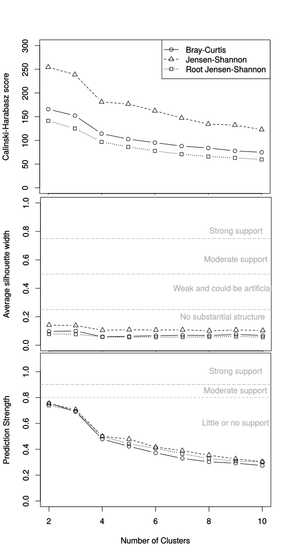
Unsupervised Clustering / “enterotypes”
Credit: Audrey Renson
Pasolli, Schiffer et al., bioRxiv 103085

Slide 19
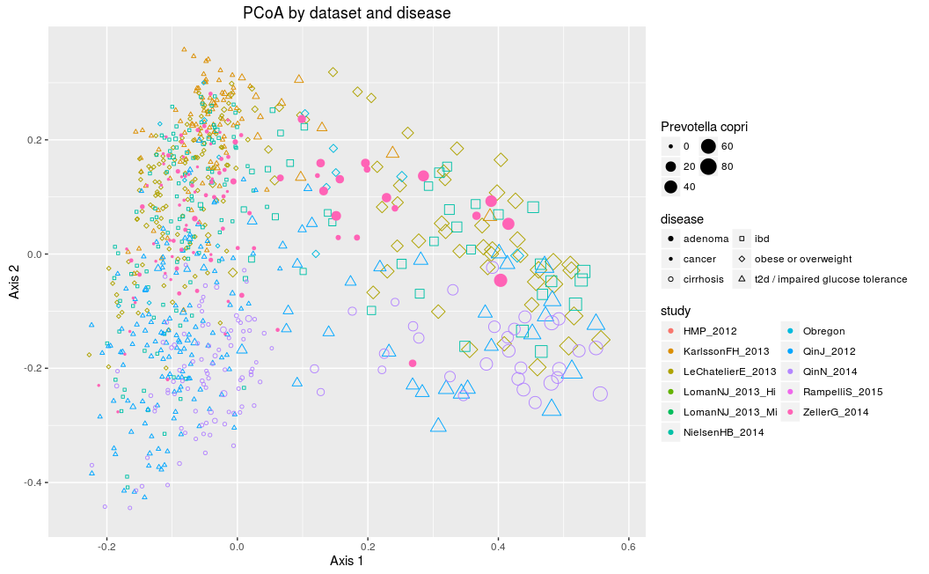
PCoA by dataset and disease
Credit: Audrey Renson
19

Slide 20
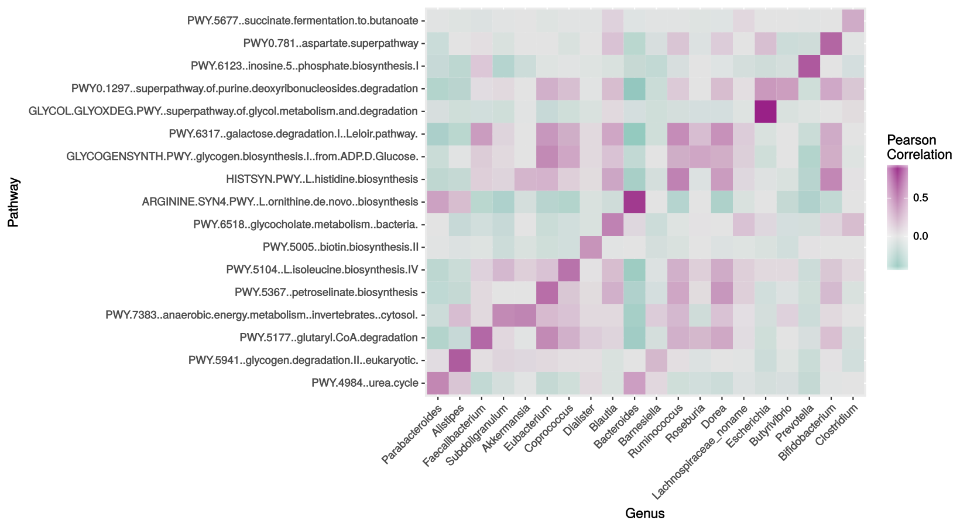
Application 3: Bug / pathway correlations
Credit: Audrey Renson

Slide 21
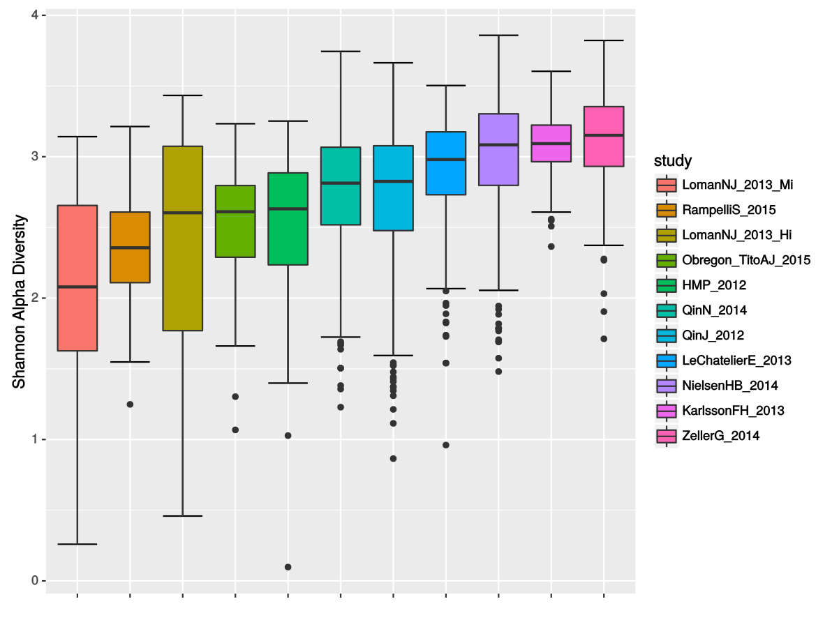
Application 4:
alpha diversity within studies
Credit: Audrey Renson
Pasolli, Schiffer et al., bioRxiv 103085

Slide 22
Application 5:
Disease classification with data products
Credit: Edoardo Pasolli
Pasolli, Schiffer et al., bioRxiv 103085

Slide 23
Future work
More data (>10K samples by 2018)
“sliceable” data format to access row subsets
Convenience function to attach dbGaP data
Integrate phylogenetic tree with phyloseq
HMP16S ExperimentHub package
Based on QIIME tables from HMPDCC
Feature and sample names standardized to match curatedMetagenomicData

Slide 24
curated*Data Bioconductor packages
curatedOvarianData
30 datasets, > 3K unique samples
survival, surgical debulking, histology...
curatedCRCData
34 datasets, ~4K unique samples
many annotated for MSS, gender, stage, age, N, M
curatedBladderData
12 datasets, ~1,200 unique samples
many annotated for stage, grade, OS

Slide 25
Thank you
Lab
Lucas Schiffer (curatedMetagenomicData)
Marcel Ramos (MultiAssayExperiment)
Audrey Renson, Ludwig Geistlinger, Rimsha Azar, Sehyun Oh, Abzal Bacchus, Andy Samedy
Collaborators
Nicola Segata lab (University of Trento, Italy)
Edoardo Pasolli, Paolo Manghi
Valerie Obenchain, Martin Morgan (Bioconductor)
CUNY High-performance Computing Center
Notes:
met Jin Xu from East China Normal University, Shanghai

